Slide 1



ENGLISH LAB: PRESENATIONS

Slide 2
Greetings & Introductions
Beginnings
Giving the plan and moving on
Conclusions
Questions
Making your presentation more interesting
PRESENATIONS
Useful phrases

Slide 3
What do you say?
GREETINGS & INTRODUCTIONS

Slide 4

GREETINGS & INTRODUCTIONS
Good morning!
Good afternoon, everyone!
Hello!
My name is…
Let me introduce myself. My name is….
Thank you all for coming here today.

Slide 5
What do you say?
BEGINNINGS

Slide 6

My presentation is called….
My talk is called…
In my presentation today, I am going to talk about…
I would like to talk about….
The subject of my presentation is…
What I’d like to present today is…
What I’d like to talk about is…
My talk is about…
My topic is…
My presentation will take about 30 minutes.
Let’s get started.
BEGINNINGS

Slide 7
What do you say?
GIVING THE PLAN & MOVING ON

Slide 8

GIVING THE PLAN & MOVING ON
My presentation has three main parts. First, I’d like to talk about…
In the first part…
Second,… / Secondly,…
Then,… / After that,… / Finally,….
I’ve divided my presentation in three parts.
Let’s start with…
First of all, let’s look at…
My next point is….
Let’s move on to….
Now let’s look at… / Have a look at this….
Now I’ll show you the….
The next slide shows…..
Here we can see…

Slide 9
What do you say?
CONCLUSIONS

Slide 10

CONCLUSIONS
In conclusion,….
Let me summarize the main points.
I’d like to finish with…
Thank you for coming.

Slide 11
What do you say?
QUESTIONS

Slide 12

QUESTIONS
If you have any questions, feel free to ask at any time.
Are there any questions?
Do you have any questions?
Any questions?

Slide 13
What do you say?
MAKING YOUR PRESENTATION MORE INTERESTING

Slide 14
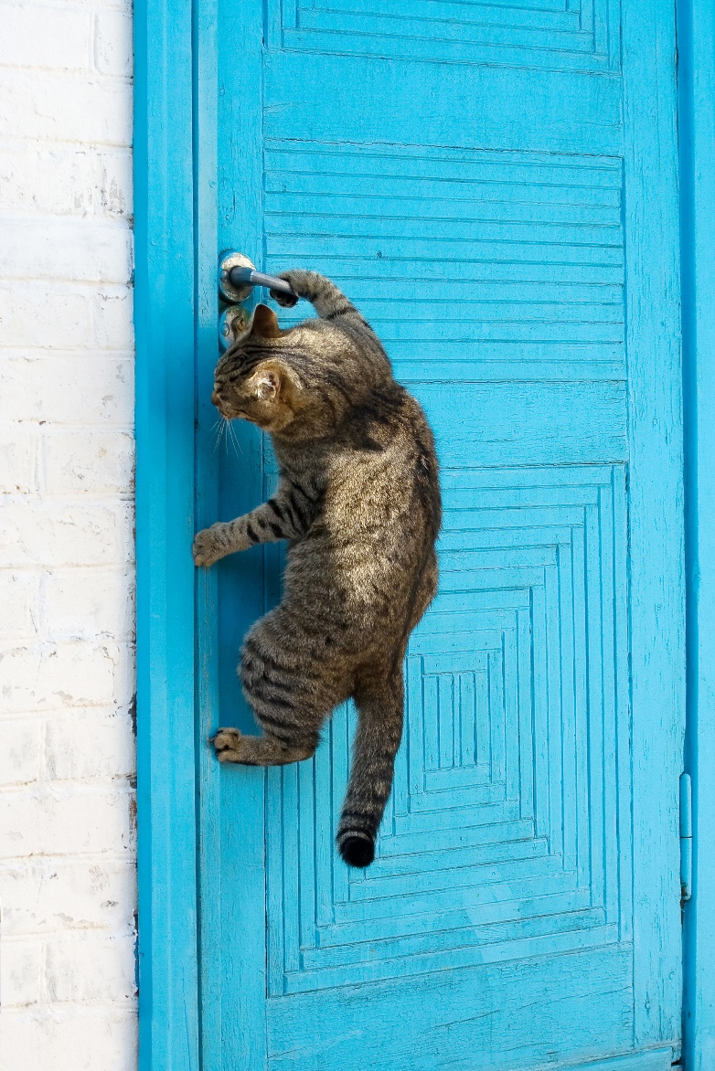
MAKING YOUR PRESENTATION MORE INTERESTING
Did you know that….?
What can we do about it?
Do we really need it?
Are we all happy about that?
Have you ever… (been / seen / done)?
I’d like to share something with you…
Let me tell you what happened to me….

Slide 15
SUMMARY
Greetings & Introductions
Hello! / Good morning!
Let me introduce myself. My name is…
Beginnings
My presentation is about…
Let’s get started.
Giving the plan and moving on
My presentation has three main parts.
First / Second / Finally…
Have a look at / The next slide shows…
Conclusions
This is the end of my presentation.
Thank you for coming.
Questions
Are there any questions?
Making your presentation more interesting
Did you know that….?

