Slide 1



ENGLISH LAB: PRESENATIONS

Slide 2
Greetings & Introductions
Beginnings
Giving the plan and moving on
Conclusions
Questions
Making your presentation more interesting
PRESENATIONS
Useful phrases

Slide 3
What do you say?
GREETINGS & INTRODUCTIONS

Slide 4

GREETINGS & INTRODUCTIONS
Good morning!
Hello!
My name is…
Let me introduce myself. My name is….

Slide 5
What do you say?
BEGINNINGS

Slide 6

BEGINNINGS
My presentation is called….
In my presentation today, I am going to talk about…
I would like to talk about….
My talk is about…
My presentation will take about 30 minutes.
Let’s get started.

Slide 7
What do you say?
GIVING THE PLAN & MOVING ON

Slide 8

GIVING THE PLAN & MOVING ON
My presentation has three main parts. First, I’d like to talk about…
Let’s start with…
My next point is…
Let’s move on to…
The next slide shows…

Slide 9
What do you say?
CONCLUSIONS

Slide 10

CONCLUSIONS
In conclusion,….
Let me summarize the main points.
I’d like to finish with…
Thank you for coming.

Slide 11
What do you say?
QUESTIONS

Slide 12

QUESTIONS
If you have any questions, feel free to ask at any time.
Are there any questions?
Do you have any questions?
Any questions?

Slide 13
What do you say?
MAKING YOUR PRESENTATION MORE INTERESTING

Slide 14
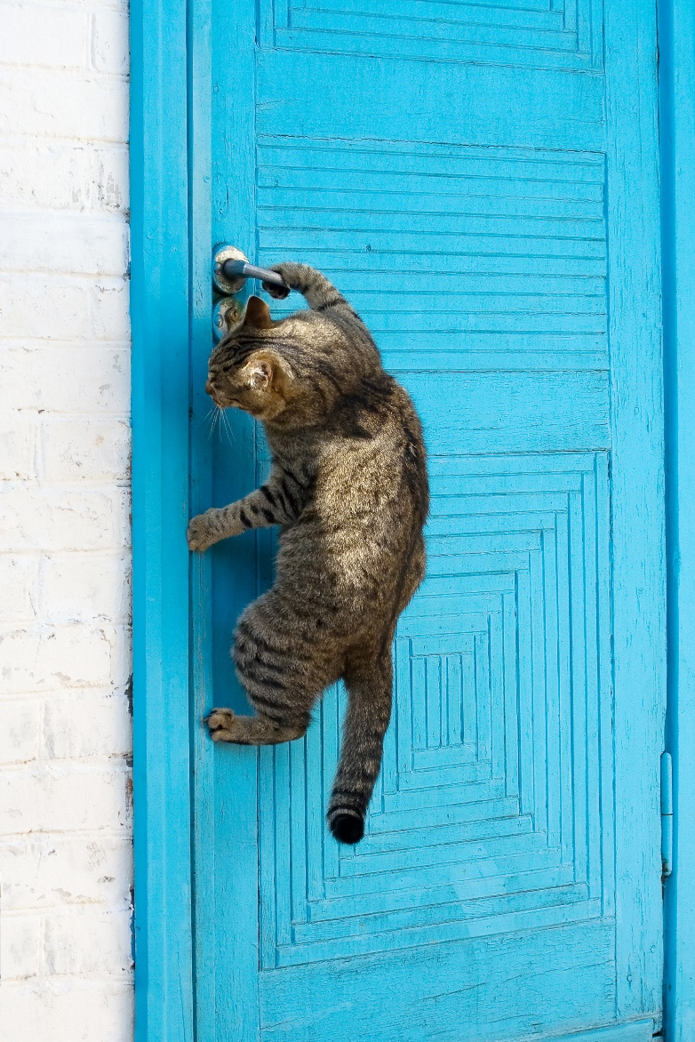
MAKING YOUR PRESENTATION MORE INTERESTING
Did you know that….?
Have you ever… (been / seen / done)?
I’d like to share something with you…
Let me tell you what happened to me….

Slide 15

SUMMARY
Greetings & Introductions
Beginnings
Giving the plan and moving on
Conclusions
Questions
Making your presentation more interesting

